Slide 1
The best strategic plan is useless if it cannot be executed tactically.
Field-Marshall Erwin Rommel
quoted in “Bottom-Up Marketing”
We must execute daily at the tactical level to achieve the long term strategic goals. Agile project management methodology is one means of execution.
Agile 101

Slide 2
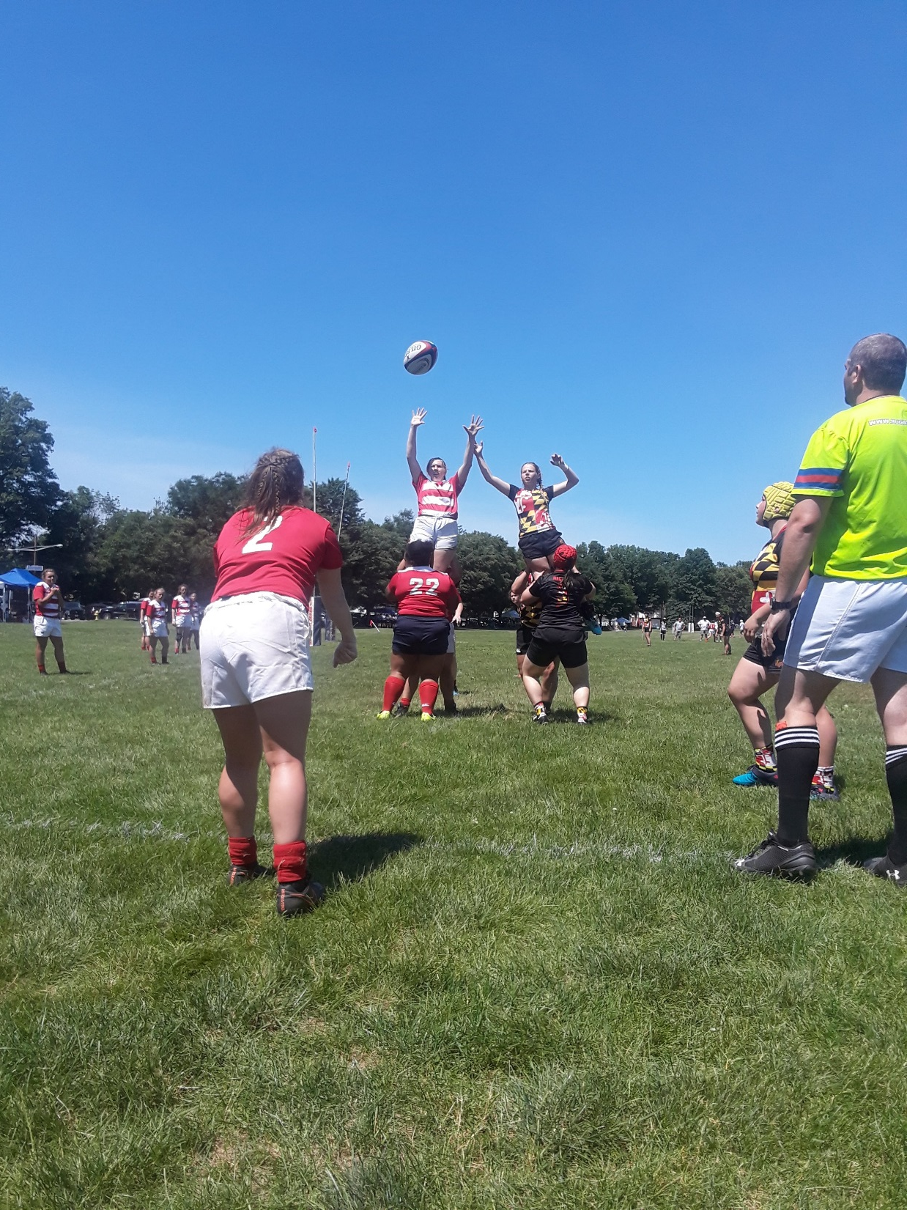
Agenda
What is Agile and its advantages
Projects Products
Requirements Feature Gathering
What is Agile Scrum
Agile Scrum How to (getting started with Agile)
What is Agile Kanban
Scalable Agile Framework (SAFe)

Slide 3
What is Agile?
A project management methodology
Emphasized close collaboration between the programmer team and business experts (the scrum team)
High amounts of face-to-face communication
Strives to get features to market
Creates high degrees of trust verses contractual agreements
Notes:
http://www.agilealliance.org/the-alliance/what-is-agile/

Slide 4
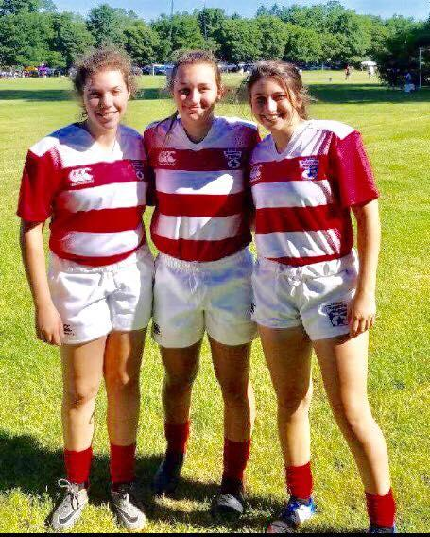
What is Agile?
Frequent delivery of new deployable business value
Tight, self-organizing teams
Ways to craft the a product and the team such that the inevitable requirements churn is not a crisis.

Slide 5
Manifesto for Agile Software Development
We are uncovering better ways of developing software by doing it and helping others do it. Through this work we have come to value:
Individuals and interactions | over processes and tools
Working software | over comprehensive documentation
Customer collaboration | over contract negotiation
Responding to change | over following a plan
That is, while there is value in the items on the right, we value the items on the left more.

Slide 6
Agile
Agile is a holistic approach
6 Characteristics of the most successful teams
Built-in instability
Management sets a board goal or a general strategic direction. The team has a wide measure of freedom and extremely challenging goals. Creativity is born from challenge.
Self-organizing project teams
Teams have a high autonomy.
Teams seek out “the limit” of the feature or product (self-transcendence)
Overlapping development phases
Team members work on discovery and determining a path, while also delivering on what was determined while all finishing within a period of time.
Notes:
HBR: the New New Product Development Game, Hirotaka Takeuchi and Ikujiro Nknaka January 1986 issue

Slide 7
Agile
6 Characteristics of the most successful teams
Multi-learning
Teams learn about the whole process of why a request for a feature is being initiated to being built. They all work on that feature part.
Subtle control
Flat organization and late of silos create solutions and teams are supported to try, adopt and release features.
Organizational transfer of learning
As the teams consist of members from wider ranges of talents, the information is shared widely.
Notes:
HBR: the New New Product Development Game, Hirotaka Takeuchi and Ikujiro Nknaka January 1986 issue

Slide 8
Scrum - an agile process
SCRUM is an agile, lightweight process for managing and controlling software and product development in rapidly changing environments.
Iterative, incremental process
Team-based approach
developing systems/ products with rapidly changing requirements
Controls the chaos of conflicting interest and needs
Improve communication and maximize cooperation
Protecting the team form disruptions and impediments
A way to maximize productivity

Slide 9
Advantages
Teams get focused on delivery of code
Multi-disciplinary teams form a scrum team and focus on a set or key deliverables.
Teams focus towards testing of code and automation of the testing as code will be more frequently tested.
Team members interact more and can articulate achievements. The product Owner has more trust in the team and directs outcomes, so they know of the achievements first hand.

Slide 10
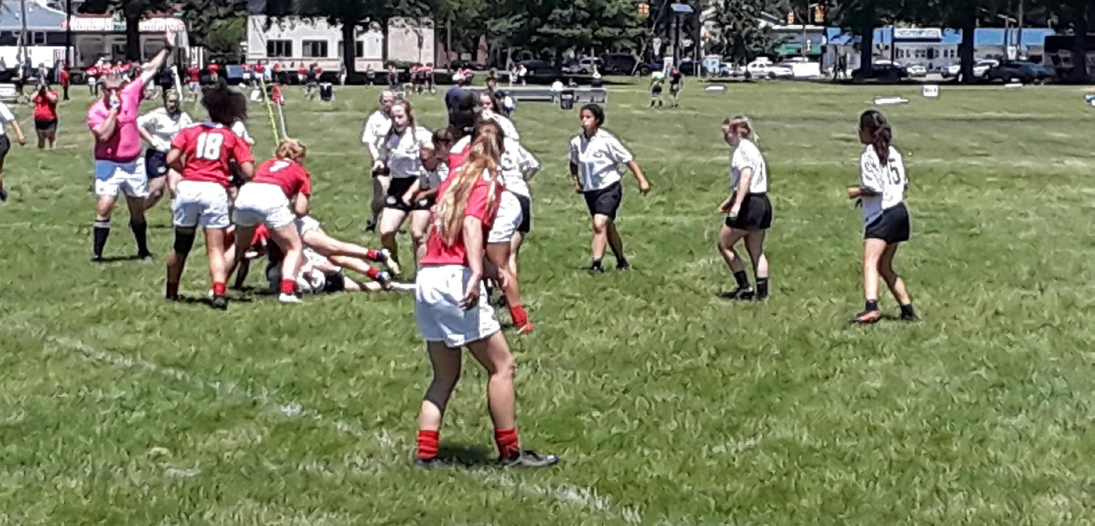
Projects Products

Slide 11
From Projects to Product Development
The project model for software development comes from the contracting industry, where trust is not part of the contract.
Agile attempts to break that down into collaboration.
When IT is inside a company, there is no reason, to setup the we-they model for doing business that projects do.
Teams should be a collaborative effort for the business end goals. Thus, with your business partner teams seek to deliver the most business value in the shortest amount of time for the lowest cost, help the business use the system effectively, and continue to deliver more and better features over time.
In particular, you do not need to fix scope at the beginning, you do not need customer sign-offs, you do not need to monitor detailed scope to schedule and you do not need to do everything that your customers say is important.
Notes:
Implementing Lean Software Development - Page 63

Slide 12
Projects to Product Development
Product
Project
Do everything that your customers say is important
Team acceptance
Backlog and User Stories of features
No fixed scope, however a ranking of features
Lots of prototyping to build a product
Plan what customer said was important
Customer sign-offs
Business and system requirements.
Fixed set of scope of requirements
Build a single project with set end date.

Slide 13
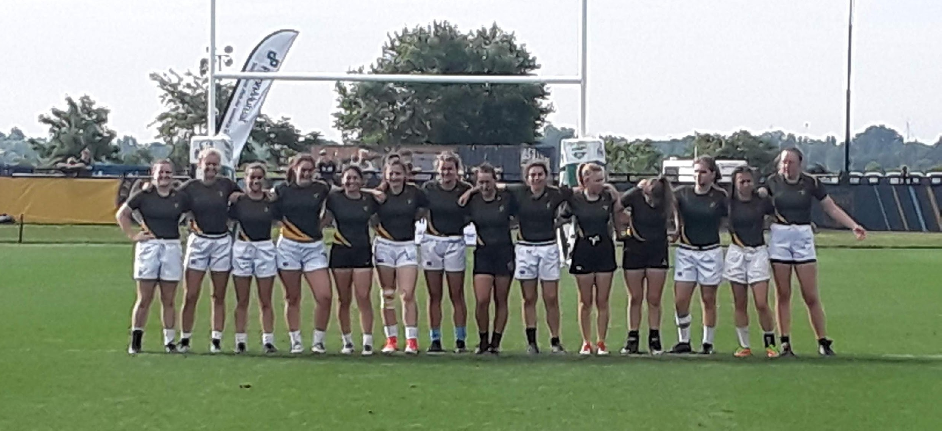
A Better Mouse Trap
Systems thinking and continuous improvement lend themselves to product perfection.
Notes:
Large-Scale Scrum p 156 to 168

Slide 14
Projects to Product Development
“I offer you Scrum, a most perplexing and paradoxical process for managing complex projects.” Ken Schwaber ‘Agile Project Management with Scrum’, Opening lines of the book.
Revised editions have “Scrum is a framework for developing and sustaining complex products.”
Scrum is about products and not projects
Product backlog
Product Owner
No project plan nor a project manager
Managing work as products rather than projects changes structures, decisions, and behaviors in product development

Slide 15
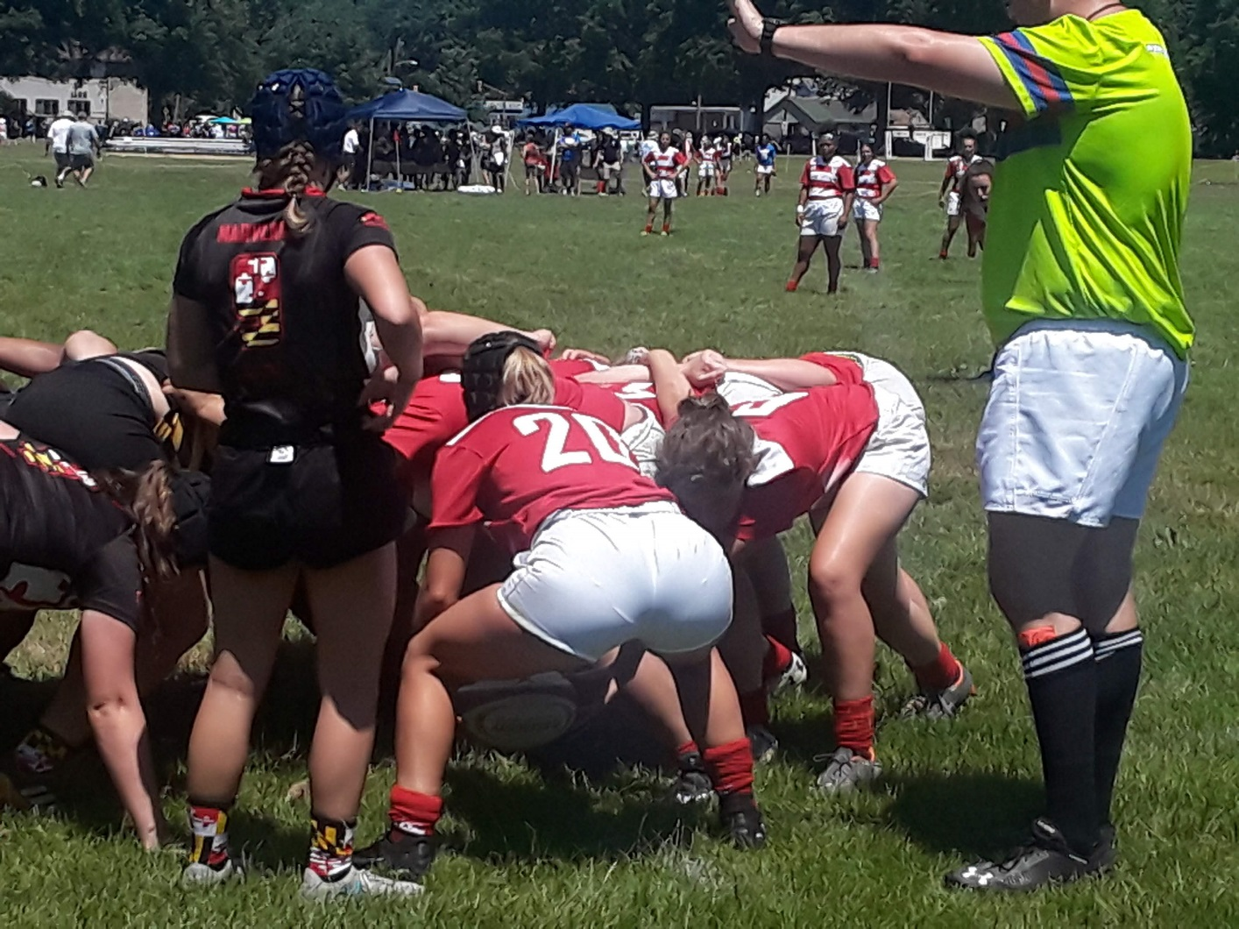
Agile Scrum

Slide 16
Agile Scrum
Short timeline to develop a small impactful feature.
Notes:
Large-Scale Scrum p 156 to 168

Slide 17
Conversion to Agile Scrum
Epic Story
Initial modelling
Themes or High level Use Cases
User Stories
Sub User Stories
Project
Project defined enough to provide estimates and to plan effort.
Project SDLC(requirements, development, test, release)
Detailed elements within project area.
A template for optimization should be used via a tool.
Eventually, we will replace Project SDLC with functional components within the project at a high level. In order to highlight time usage and keep the flow looking familiar without setting up Jira predecessors, we will used SDLC and map
to them to themes.

Slide 18
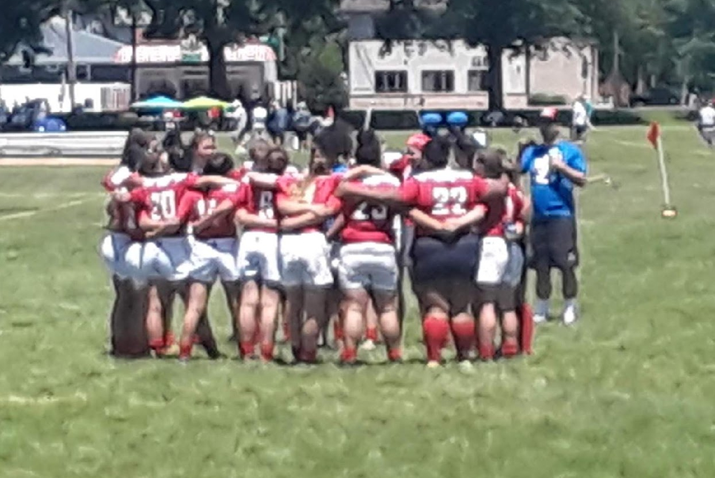
The Scrum Team
Typically 5-10 people
Cross-functional (product experts, QA, Developers, DBAs, UI Designers, Testers, etc.)
Members should be full-time
Team is self-organizing
Membership can change only between sprints

Slide 19
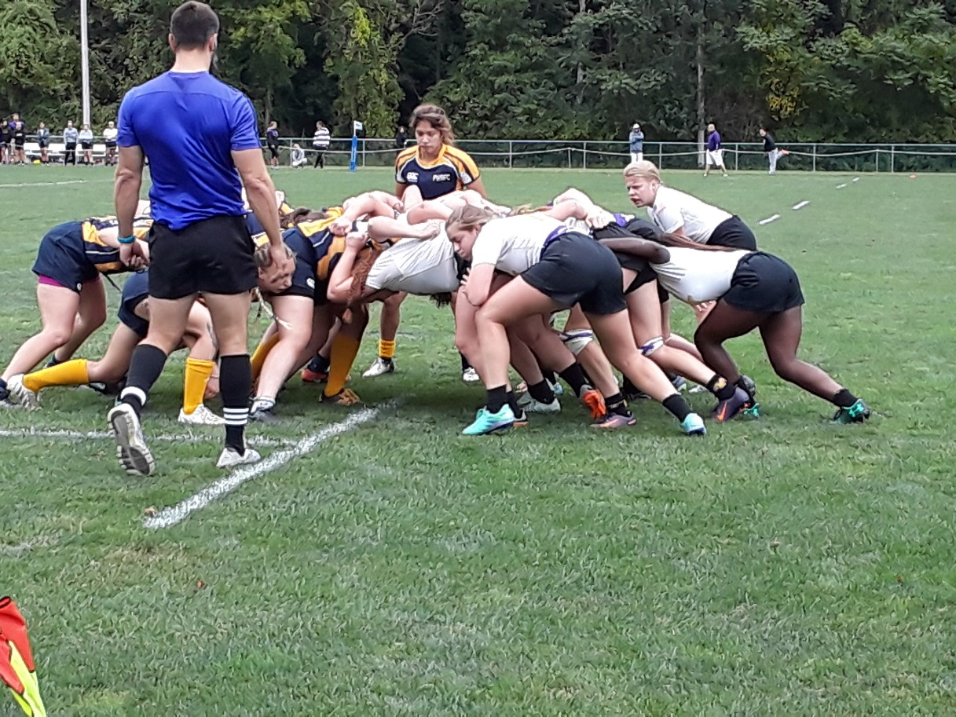
Product Owner
Acts like one voice
Knows what needs to be build
Desired sequence for feature implementation
Typically a product manager

Slide 20
Scrum Master
Represents management to the project
Typically filled by a Project Manager or Team Leader
Responsible for enacting scrum values and practices
Main job is to remove impediments

Slide 21
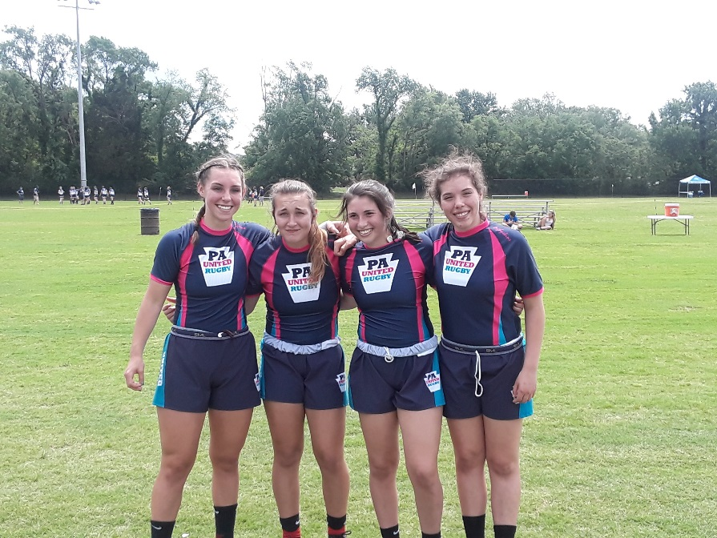
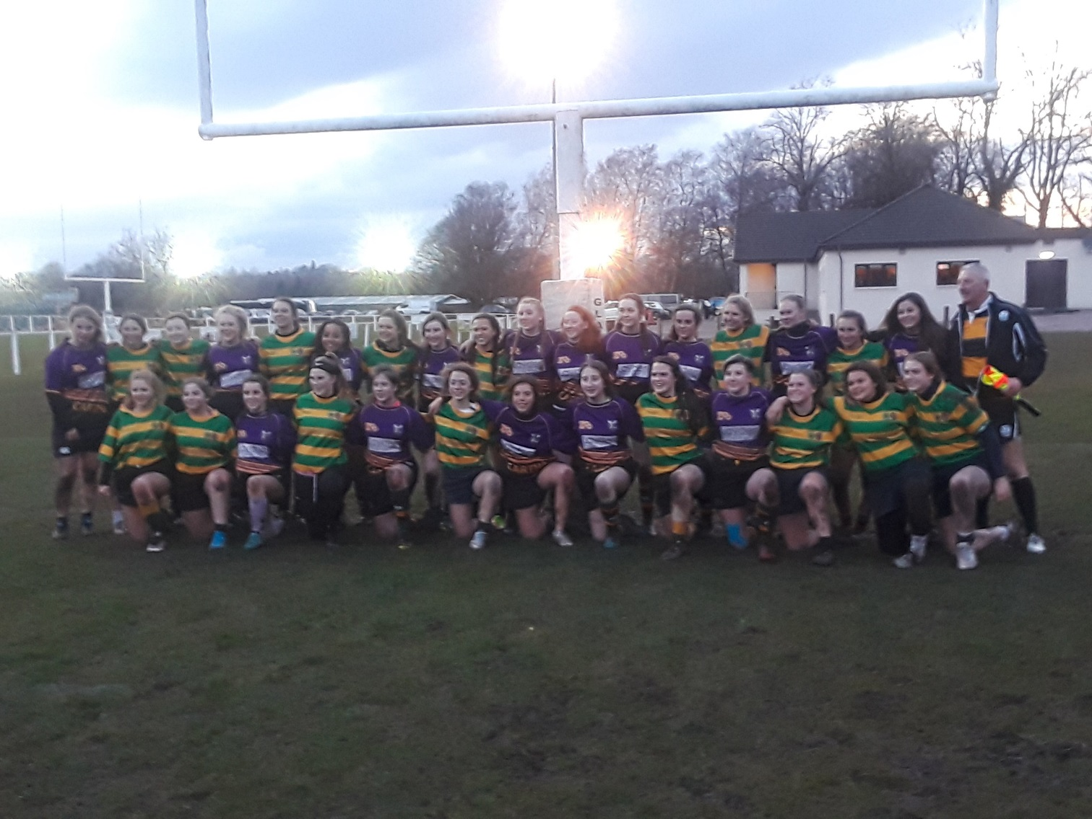
Agile Scrum How to

Slide 22
Going Agile
Create a Product Backlog of what you know needs to be accomplished.
How well do you know what needs to be accomplished?
What documentation is in place and what is needed?
Have user stories been broken down or still high level
What estimation can be accomplished for each item in the backlog.
Form a Scrum Team
A fully dedicated team with the sole purpose is to complete a set of work.
Great developers/engineers who can accomplish the effort.
The best testers you can find to debug is thoroughly.
Notes:
Agile software development with Scrum: Pages 62 to 63

Slide 23
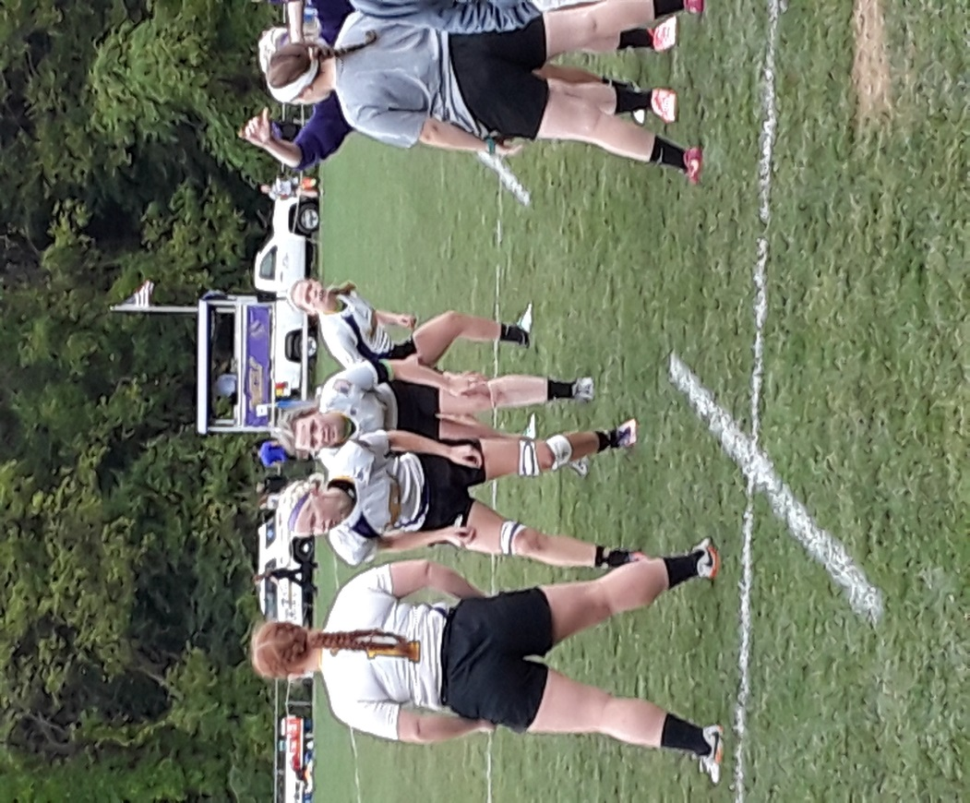
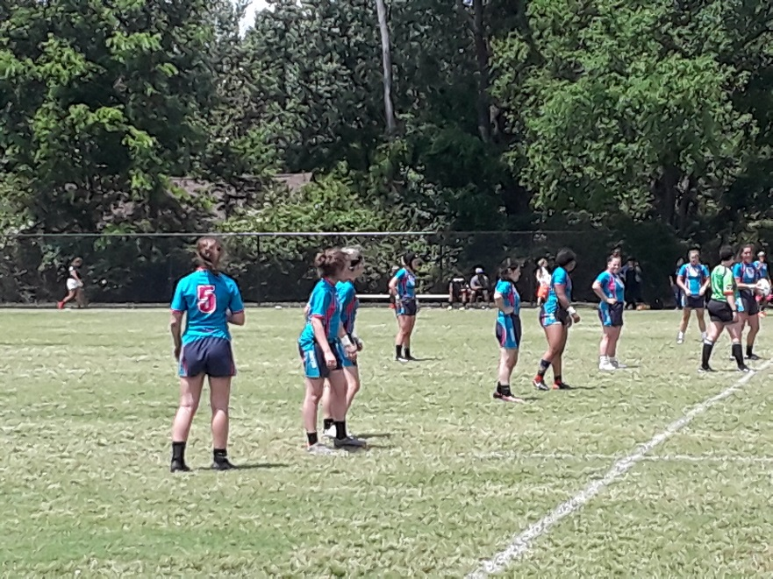
Going Agile
Project budget will consist of the team budget, consultant cost, overhead, hardware, and software cost.
A completion date – based on the backlog of items for this release, what is a date to accomplish the effort?
Put the tools in place
Project site for project artifacts, Jira site for tracking efforts and issues.
GitHub, Confluence, IDE, etc

Slide 24
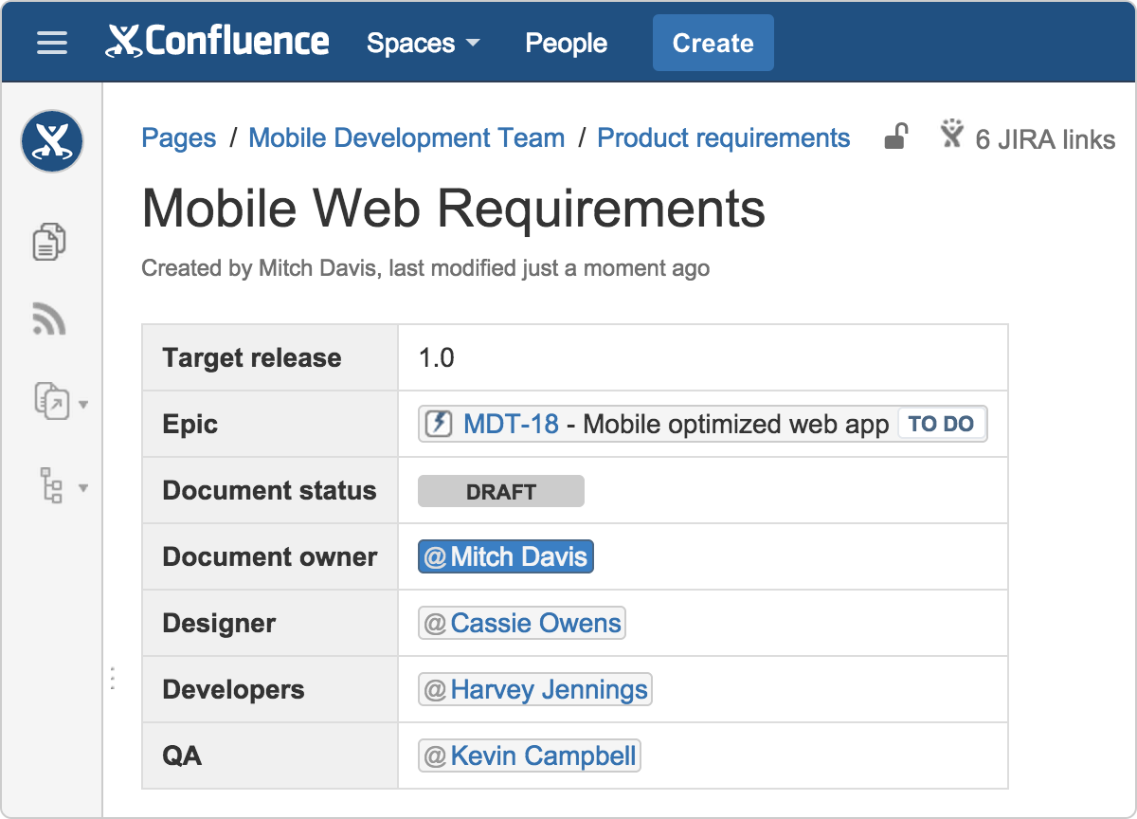
Agile Project Charter
Basic information about the product
Name, product site (SharePoint), Jira site, start date, and estimated deliver date or due date
Key People
Champion, Sponsor, Key Stakeholders, Key Subject Matter Experts
Notes:
http://michaellant.com/2010/05/18/how-to-make-your-project-not-suck/
https://www.atlassian.com/agile/product-management/requirements

Slide 25
Agile Project Charter
An Agile Charter has three primary components:
Vision: The vision defines the “Why” of the project. This is the higher purpose, or the reason for the project’s existence.
Mission: This is the “What” of the project and it states what will be done in the project to achieve its higher purpose. This should include technical, business, product, and team objectives.
Success Criteria: The success criteria are management tests that describe effects outside of the solution itself.
Notes:
http://michaellant.com/2010/05/18/how-to-make-your-project-not-suck/

Slide 26

Product Backlog
Roadmap
Plan of action for how a product or solution will evolve over time.
Product owners use roadmaps to outline future product capabilities and when new features will be released.
Needs to be shared with the entire product team so everyone understands the vision and direction.
Requirements
Notes:
https://www.atlassian.com/agile/product-management/requirements
https://www.atlassian.com/agile/product-management/roadmaps

Slide 27
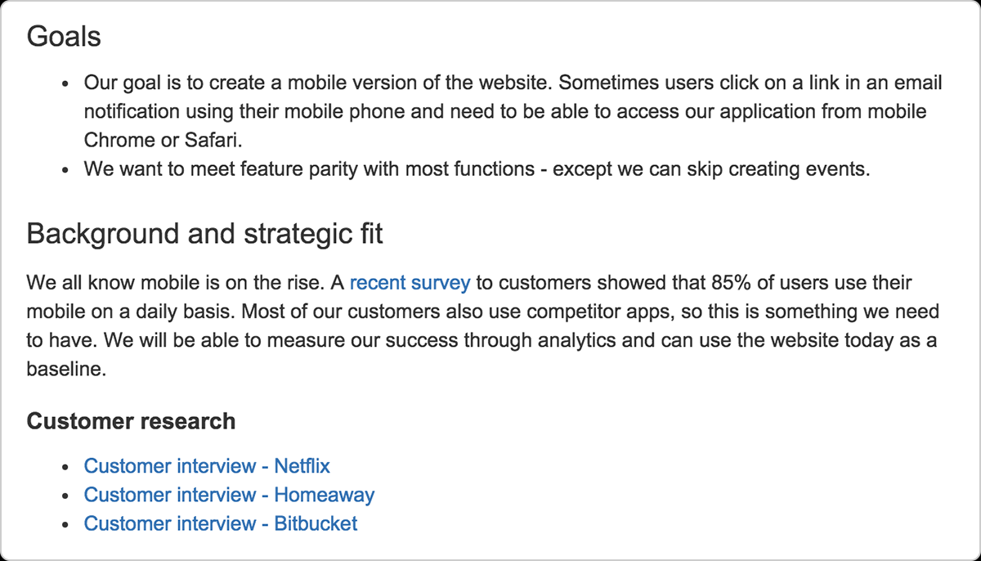

Slide 28
Product Backlog Example
PN/CR# | Title | Ranking | Priority | Sprint
PN-824 | List Score Items Correctly on List of Items in Form Report | 0 | High | 1.00
CR-160 | Support Administration-Independent Flagged-as-Final Conversions | 0 | Critical | 2.00
CR-27 | Reliability Stats by LIC. | 0 | High | 3.00
CR-167 | Conversion Status by Admin Report | 0 | High | 4.00
PN-744 | GEN II - IA CLASSICAL - Change Flag Option Values | 3 | High | 5.00
PN-863 | Additional IA is generated when constituent admins have different SFCs | 8 | High
Currently in sprint 5, all above items were completed in earlier sprints.
Additional fields: development status, comments, client signoff, client notes, estimate of time.

Slide 29
Backlog
https://www.atlassian.com/agile/scrum/backlogs
https://projectresources.cdt.ca.gov/agile/the-agile-project-charter/
https://go.keyedin.com/hubfs/KIP_WEBSITE_ASSETS/KIP_UK_WEBSITE_ASSETS/eBook%20Why%20PPM%20and%20PMOs%20Fail.pdf?hsLang=en-us&t=1528724821319
https://www.smartsheet.com/agile-project-management-excel-templates

Slide 30
Features
Epic
Theme
User Story
As a frequent flier, I want to check my account
As a frequent flier, I want to
Frequent Flyer
As a frequent flier, I want to collect free miles
As a frequent flier, I want to book a trip
As a frequent flier, I want to re-book often trips
As a frequent flier, I want to update my personal data.
Release
Incremental Release
Sprint

Slide 32
Features and User Stories
We deliver features to our customers, not user stories
Features can be tested by the end-users, user stories is not necessarily fully testable for the end-user.
In many cases testing a user-story until fully integrated with the rest of the feature might only make sense to the developer. Eg. testing a credit card validation in an online shop makes little sense to the end user unless he can also add items to a shopping cart and proceed to checkout.
A feature/epic can span several sprints, one user story should never span more than one sprint, it only indicates you're missing granularity in your user stories
One feature/epic can contain several user stories

Slide 33
User Stories
Request for valuable stuff
User Story Template
As a <Some Role> I want <Something> So that <Some value or Justification>

Slide 34
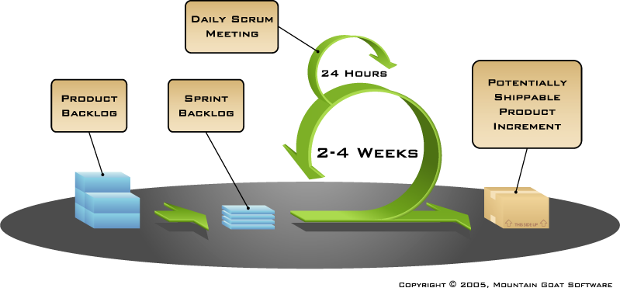
Framework of Agile Scrum
Notes:
Basic components of Agile Scrum
Describe each

Slide 35
Product Backlog
Feature enhancements
AKA Requirements for a system
Features are expressed as a prioritized list of Backlog Items
Is managed and owned by a Product Owner
Spreadsheet (typically)
Usually is created during the Sprint Planning Meeting
Can be changed and re-prioritized before each Sprint
These are enhancements (CR) or bug fixes (PN)

Slide 36
Product Backlog Example
PN/CR# | Title | Ranking | Priority | Sprint
PN-824 | List Score Items Correctly on List of Items in Form Report | 0 | High | 1.00
CR-160 | Support Administration-Independent Flagged-as-Final Conversions | 0 | Critical | 2.00
CR-27 | Reliability Stats by LIC. | 0 | High | 3.00
CR-167 | Conversion Status by Admin Report | 0 | High | 4.00
PN-744 | GEN II - IA CLASSICAL - Change Flag Option Values | 3 | High | 5.00
PN-863 | Additional IA is generated when constituent admins have different SFCs | 8 | High
Currently in sprint 5, all above items were completed in earlier sprints.
Additional fields: development status, comments, client signoff, client notes, estimate of time.

Slide 37
Sprint Planning Meeting
A collaborative meeting in the beginning of each Sprint between the Product Owner, the Scrum Master and the Team
Takes 8 hours and consists of 2 parts
ETS BTDT meets for a shorter period of time. However, the first two did take about this long. Several smaller SA / developer meetings occur before the sprint planning meeting to firm up change request and bug fixes. This organic nature shortens the sprint planning meeting and it now becomes a priority meeting.

Slide 38
Parts of Sprint Planning Meeting
1st Part:
Updating Product Backlog
Determining the Sprint Goal
Participants: Product Owner, Scrum Master, Scrum Team
2nd Part:
Participants: Scrum Master, Scrum Team
Creating Sprint Backlog
Notes:
Since problems are tracked in Silk, product backlog in Excel is updated when a new PN is opened.
Sprint goal almost always is to deliver the highest value CR/PNs to SA.
Part 2 takes typically about 1.5 to 2 hours.
We pass out PN and CR information to cut down the time it takes. Once ranked in Sprint 1, the updates concern the priority is. Also, new PNs are reviewed.

Slide 39
Sprint
A 2 - 4 week iteration
An increment a product functionality is completed
Sprint durations vary, the team determines
NO outside influence can interference with the Scrum team during the Sprint
Ensure staff do not lose time to production issues
Outside meetings keep to a minimal.

Slide 40
Stories to Sub-Task
User Stories get broken down into sub-task
Sub-task are less than 16 hours
Sub-tasks get added to sprints.
PN/CR# | Title | Rank Order | Role | Task | Status | Original Estimate Hrs
PN-852 | Incorrect Polytomous Item Category Weight | 25 | FORTRAN Developers | Analysis | Complete | 6
 |  |  | FORTRAN Developers | Coding | Complete | 2
 |  |  | FORTRAN Developers | Unit Testing | Complete | 4
 |  |  | FORTRAN Developers | Fortran Regression Testing | Complete | 4
 |  |  | Testers | Test | Complete | 6

Slide 41
Daily Scrum
Is a short (15 minutes long) meeting
Participants: Scrum Master (which is the chairman), Scrum Team
Every Team member should answer on 3 questions

Slide 42
Daily Questions
What have you done since the last Scrum meeting?
What are you doing for the next Scrum?
What is stopping you or getting in your way to accomplishing your work?

Slide 43
Daily Scrum
Is NOT a problem solving session
Is NOT a way to collect information about WHO is behind the schedule
Is a meeting in which team members make commitments to each other and to the Scrum Master
Is a good way for a Scrum Master to track the progress of the Team

Slide 44
Burn Down Chart

Slide 45
Dashboard
GEN II Testing Dashboard week ending 7/19/2013 *Percent Complete=Includes both testing time and progress on software development. |  |  |  |  | Not yet attempted
 |  |  |  |  | Successfully Complete = Critical and High PNs and CRs are addressed and SA has signed off on use of GEN II for this request for this build.
 |  |  |  |  | Attempted with PNs/CRs Documented
 |  |  |  |  | Significant PN/ CR Identified
Program/Test | Analysis | FATs | RATs | Generate and Run Request | Comparison Review | Stat Comments/Pending Fixes
TX - 129 - Speech | PIA | X | X | X | X
 | EQ | X | X | X | X | Form not indicated on Smoothed Frequency Plots (PN-832) required; Braiding Plan-Single Group Design, not critical (CR-133)
 | FIA | X | X | X | X | Measure Type description added to Speededness report (PN-893)
 | PIA- Synthetic Admin | X | X | X | X
 | EQ- Synthetic Admin | X | X | X | X | CR-133 Braiding Plan-Single Group Design (not critical)
TX - 131 – ELAR | FIA | X | X | X | X | Measure Type description added to Speededness report (PN-893)
 | EQ | X | X | X | X | Form not indicated on Smoothed Frequency Plots (PN-832)

Slide 46
https://www.atlassian.com/agile/kanban
https://www.atlassian.com/agile/product-management/roadmaps
https://www.atlassian.com/agile/product-management/requirements
https://www.atlassian.com/agile/product-management
https://www.atlassian.com/agile/scrum/backlogs
https://www.atlassian.com/agile/product-management/roadmaps

